Slide 1
SQL Basics
Notes:
Hi everyone, I’m Vero (Cory) and this is Cory (Vero). Thanks for joining us to today’s workshop.
At the Booth Analytics Club one of our missions is to provide functional trainings in data analytics tools. Because so many of us will be using SQL in our summer internships and full time jobs, we decided to have SQL be our first workshop this Spring. Thanks to all of you who filled the survey saying which workshops and activities you’d like to see this year. Remember that next week you can attend the intermediate level workshops.

Slide 2
Agenda
What is SQL?
Who uses SQL and for what?
How does one use SQL?
How to learn more
2
Notes:
2

Slide 3
“Querying” SQL?
SQL stands for “Structured Query Language”
SQL is a way to pull the information you need out of a relational database (“query”)
You’ll probably use it to fetch summary information from a central data warehouse and then do additional analysis in Excel/R/etc.
3
Notes:
3
SQL (sequel or ess-que-el) is a language designed to manage data held in a relational database management system (RDBMS). (we’ll talk about rdms in a minute).
The most common operation in SQL is the query, which we will use to retrieve data from one or more tables.
Just so you now, standard querying statements will not modify the database, just pull data.
Queries allow us to describe what the desired data looks like, leaving the database management system to optimizing and perform the operations necessary to produce the output we want.
Prior to Booth I was a Data Analyst in an ecommerce company, and I worked in the personalization sector. So my job was to build statistical models to predict what product a person would buy next. To do this I needed the data on the sales we had. And to get this data, I had two alternatives: I could go to a Business Intelligence Analyst and ask them to pull that data -and usually the response was: “sure, I can have it by next week”- or I could learn SQL, and pull the data myself in a few hours. My lesson is that learning SQL gives you access to the source of data and you won’t be depending on anyone.

Slide 4
What is SQL?
A tool for relational database management system
Table Name
Field Names
evaluations
Course | Instructor | Quarter | Year | Hours | Rating
30000 | Ball, Ray | SPR | 2015 | 3.8 | 4.1
30000 | Bischof, Jannis | AUT | 2013 | 3.6 | 4.5
30001 | Gallemore, John | SPR | 2015 | 6.1 | 4.3
Rows of data
4
Notes:
4
SQL is the language we will use to pull data from a relational database management system.
What is a relational database?
A relational database is a collection of data items organized as a set of tables.
In each table (which is sometimes called a relation) there are one or more data categories in columns.
Each row contains a unique instance of data for the categories defined by the columns.
You’ve all used Excel before and are familiar with tables—they’re similar to spreadsheets. Tables have rows and columns just like Excel, but are a little more rigid. Database tables, for instance, are always organized by column, and each column must have a unique name.

Slide 5
What is SQL?
A tool for relational database management system
clients
orders
items
Client ID | Client Name
30000 | Booth Systems
40000 | Kellogg Inc
Order Number | Client ID | Date
1234 | 30000 | 5/17
1235 | 30000 | 5/18
1236 | 40000 | 5/17
Order Number | name | color
1234 | egg_chair | white
1234 | eames_chair | red
1234 | barcelona _chair | black
5
Notes:
5
For example, a typical business order entry database would include a table that described a client with columns for name, address, phone number, and so forth.
Another table would describe an order: product, client id , date, sales price, and so forth.
There could be a table for each order, containing which items were purchased, with a description of the product, name, color.
Every user of the database might pull different views or reports depending on their needs. For example, a branch office manager might like a view on all customers that bought products after a certain date. A financial services manager in the same company could, from the same tables, obtain a report on accounts that needed to be paid.

Slide 6
SQL vs Excel
Excel is good at:
Excel is bad at:
Usability
Ability to easily edit data
Sharing data
Learning curve
Scaling
Data Integrity
Working with multiple datasets at once
Version Control

Slide 7
Who Uses SQL?
Everyone
Companies that use MySQL:

Slide 8
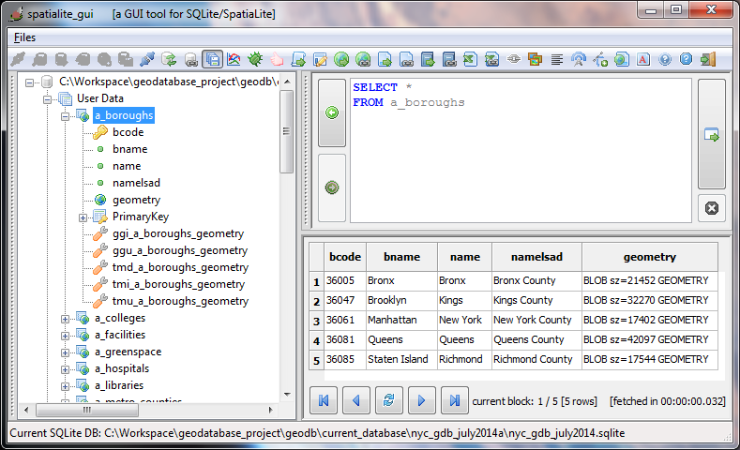
How do you use SQL?
For most MBA students, you will access SQL through a GUI (graphical user interface)
Notes:
A graphical user interface (GUI) is computer program that uses windows, icons and menus and which can be manipulated by a mouse (and often to a limited extent by a keyboard as well). GUIs contrast with command line interfaces (CLIs), which use only text and are accessed solely by a keyboard.
A major advantage of GUIs is that they make computer operation more intuitive, and thus easier to learn and use. For example, it is much easier for a new user to move a file from one directory to another by dragging its icon with the mouse than by having to remember and type seemingly arcane commands to accomplish the same task.

Slide 9
GUI for Today: Mode Analytics
Go to https://modeanalytics.com
or just search “Mode Analytics”
Sign in using these credentials
boothanalytics@gmail.com
PW: ilovesql
If you have any trouble, just create an account. It’s free and doesn’t ask for anything but email address

Slide 10
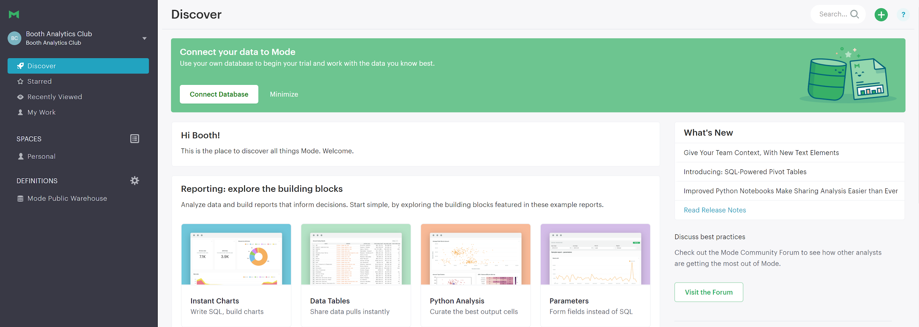
Click the Green Plus Sign

Slide 11
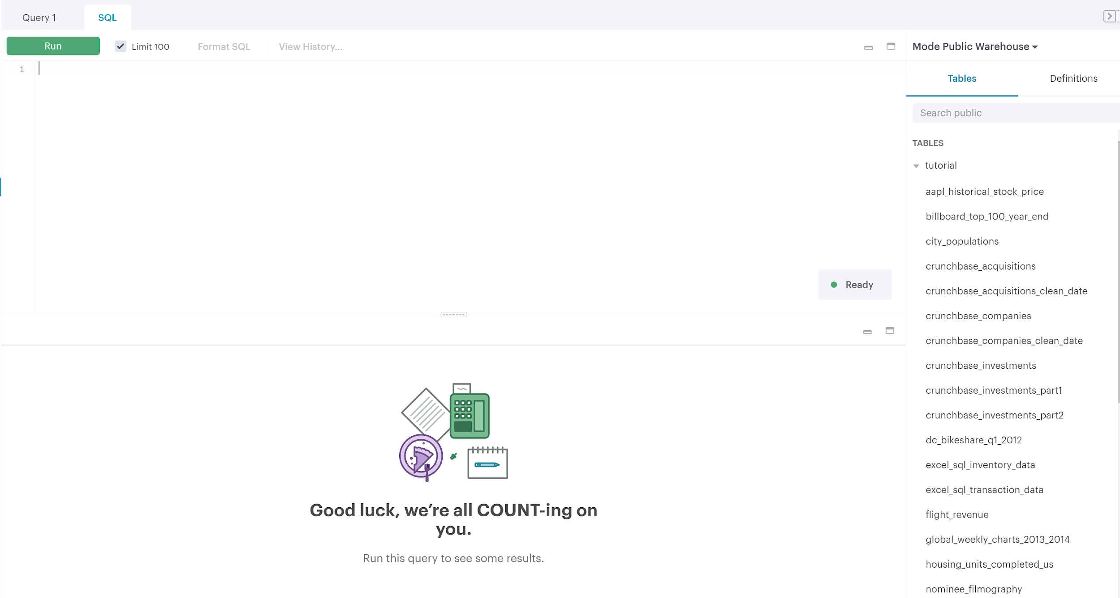
Welcome to the editor!
Query Editor
Tutorial Tables
Results

Slide 12
Three Steps to Querying
Know your database, know your tables
Write your query
Check to see if your data makes sense

Slide 13
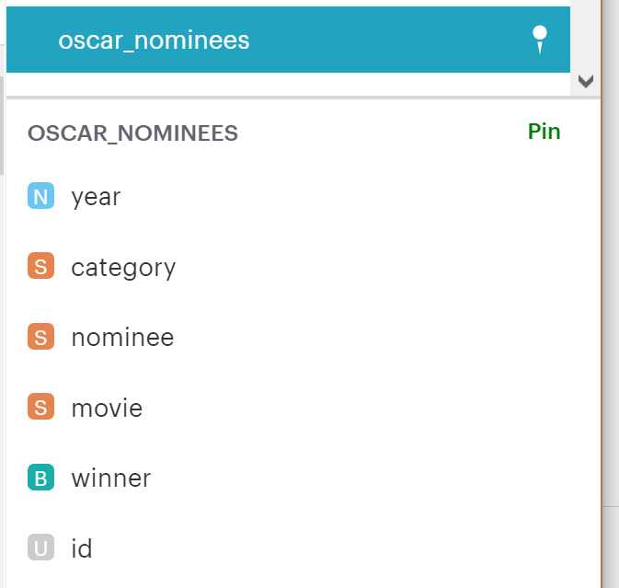
Looking at Tables
In Mode, each table has a dropdown that shows what’s in the table
Notes:
The first thing you want to know about your database is what is in there. For that you have several commands like DESCRIBE, SHOW, HELP, VIEW.

Slide 14
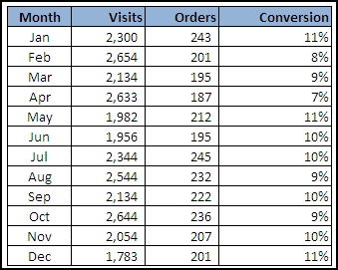

The Three Building Blocks
Queries usually have three main building blocks:
SELECT, FROM, and WHERE
SELECT Month, Visits
FROM example_table
WHERE Conversion = ‘9%’
Notes:
The first thing you want to know about your database is what is in there. For that you have several commands like DESCRIBE, SHOW, HELP, VIEW.

Slide 15
The Building Blocks: Select and From
Every query has two necessary components: Select and From
SELECT year, nominee, movie
FROM tutorial.oscar_nominees
Database.Table_Name

Slide 16
Picking and Renaming Columns
It can be useful to specify, rename, and reorder columns.
SELECT movie AS film, year, category
FROM tutorial.oscar_nominees
Notes:
Remember, you can customize the view of the data you are querying. So for example you can rename columns. This renames columns only for your view. It doesn’t alter the database.

Slide 17
WHERE: The Third Building Block
Add a WHERE clause to your query to filter results
SELECT *
FROM tutorial.oscar_nominees
WHERE year = 2005
Note: if you set one of your columns equal to a text string, use apostrophes. Ex: nominee = ‘Amy Adams’

Slide 18
Try it!
Use SELECT, FROM, and WHERE to answer the following questions:
Who was the Best Actress winner in 2002?
2) How many oscars did A Streetcar Named Desire win (in all categories)?
Hint: Use AND to add extra conditions.
Ex: WHERE year = 1998
AND movie = ‘Shakespeare in Love’

Slide 19
Hint
If you want to explore the table a bit, try using DISTINCT. This will pull one row for each unique result in your query.
Ex:
SELECT DISTINCT category
FROM tutorial.oscar_nominees

Slide 20

Answers
Who was the Best Actress winner in 2002?
Nicole Kidman
You’re a SQL expert already!
SELECT nominee
FROM tutorial.oscar_nominees
WHERE year = 2002
AND category = ‘actress in a leading role’
AND winner = ‘true’

Slide 21
Answers
2) How many Oscars did A Streetcar Named Desire win (in all categories)? 3
SELECT movie, category, winner
FROM tutorial.oscar_nominees
WHERE movie = ‘A Streetcar Named Desire’
AND winner = true

Slide 22
Using WHERE Statements (Comparison)
< Greater Than
> Less Than
= Equals
!= or <> Not Equals
>= Greater Than or Equal To
<= Less Than or Equal To

Slide 23
Comparison Example
What were the best movies of the 90’s?
Table: tutorial.nominee_filmography

Slide 24
Comparison Example
SELECT DISTINCT movie_title, rating
FROM tutorial.nominee_filmography
WHERE rating > 8
AND year < 2000
AND year >= 1990
Note: We are limited to films that had nominated actors and actresses. Also, watch out for duplicates!

Slide 25
Try it!
Since the beginning of 2010, how many days has Apple’s stock traded at a volume of less than 7 million (excluding days with 0 volume)? What are those dates?
Find the table
Get familiar with the columns and fields
Use comparative WHERE statements

Slide 26
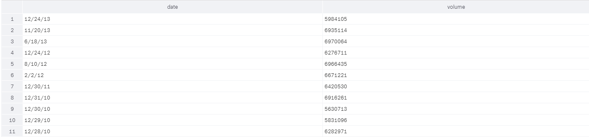
Answers
SELECT date, volume
FROM tutorial.aapl_historical_stock_price
WHERE year >= 2010
AND volume < 7000000
AND volume <> 0

Slide 27
Using WHERE Statements
(Logical)
LIKE Results similar to a criteria
IN Use a list of criteria
BETWEEN Results between two values
IS NULL Returns NULL values
AND AND operator
OR OR operator
NOT Used to exclude
(NOT IN, NOT LIKE, NOT BETWEEN)

Slide 28
Example I
What are the populations of cities that start with S?
tutorial.city_populations

Slide 29
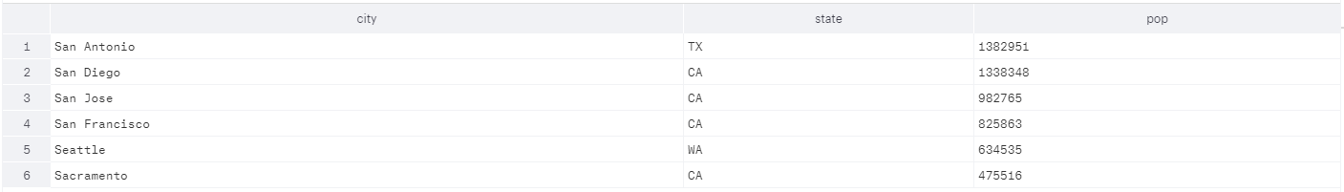
Example I
What are the populations of cities that start with S?
SELECT city, state, population_estimate_2012 as pop
FROM tutorial.city_populations
WHERE city LIKE ‘S%’

Slide 30
Example II
What are the medium-sized cities on the West Coast?

Slide 31
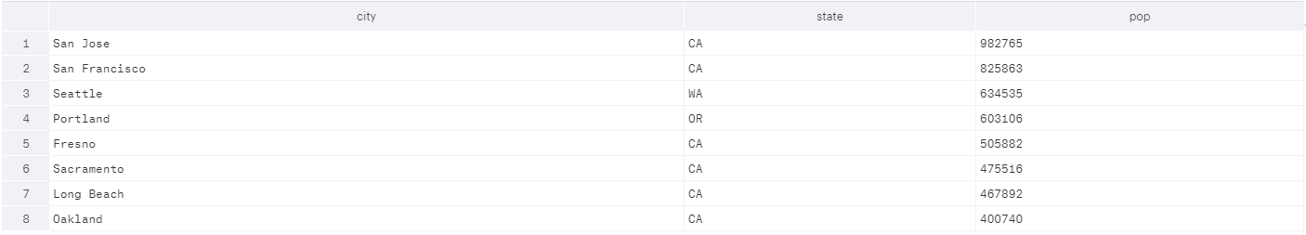
Example II
What are the medium-sized cities on the West Coast?
SELECT city, state, population_estimate_2012 as pop
FROM tutorial.city_populations
WHERE state IN (‘CA’, ‘WA’, ‘OR’)
AND population_estimate_2012 BETWEEN 200000 and 1000000

Slide 32
ORDER
Add an ORDER clause to sort your query by one or more columns, in ascending or descending order
ORDER Column1 ASC, Column2 DESC, ...
SELECT *
FROM tutorial.oscar_nominees
ORDER year ASC

Slide 33
Try It!
What are the 10 biggest cities outside of New York, Texas, Florida and California?

Slide 34
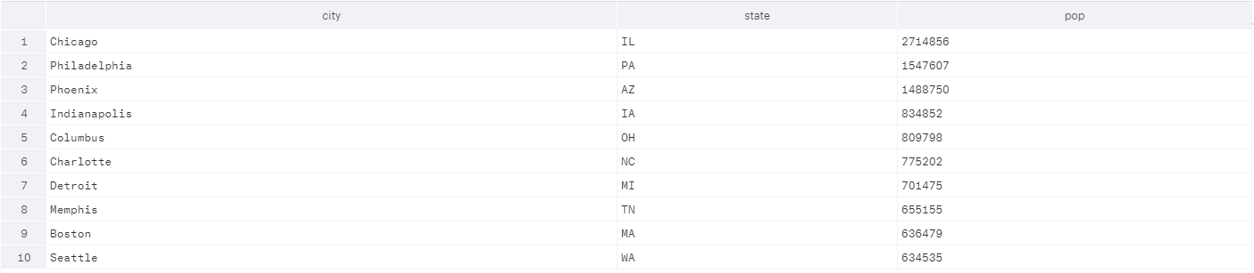
Answer
What are the 10 biggest cities outside of New York, Texas, Florida and California?
SELECT city, state, population_estimate_2012 as pop
FROM tutorial.city_populations
WHERE state NOT IN (‘CA’, ‘TX’, ‘FL’,’NY’)
ORDER by 3 DESC
LIMIT 10
Note: Orders by the third column in descending order. Can also use ascending (ASC)

Slide 35
PSA:
Always Know your Tables!
tutorial.city_populations only has the top 50 cities and excludes Washington DC!

Slide 36
Try it!
List all teas, beverage, and canned jar goods by price per unit, with the most expensive first.
(tutorial.excel_sql_inventory_data)
Note: Get familiar with the data. Beverage is a category, but tea is not!

Slide 37
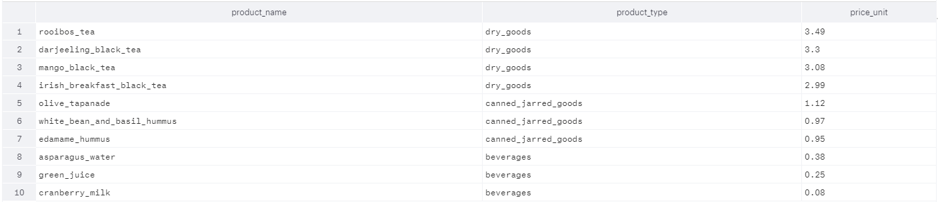
Answers
SELECT product_name, product_type, price_unit
FROM tutorial.excel_sql_inventory_data
WHERE product_name LIKE ‘%tea’
OR product_type IN (‘beverages’,’canned_jarred_goods’)
ORDER by 3 DESC

Slide 38
Aggregate Functions
COUNT Returns the number of rows
SUM Adds the fields together
MIN Finds the minimum of the column
MAX Finds the maximum of the column
AVG Averages the fields

Slide 39
Example I
SELECT school,
AVG(sat_math),
MAX(sat_math),
MIN(sat_math)
FROM tutorial.sat_scores
GROUP by 1
Note: When you have an aggregate function, you must use “GROUP by” for all non-aggregate selections

Slide 40
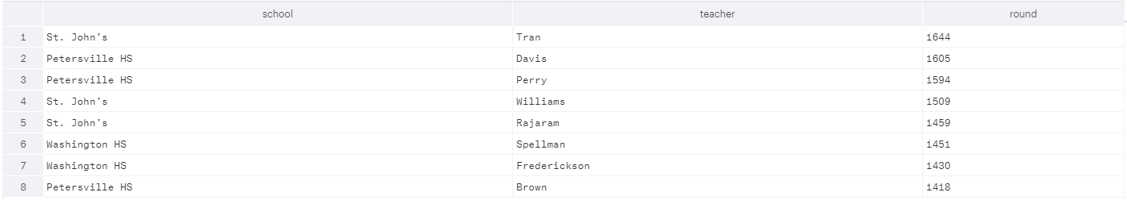
Example II
We can also use arithmetic in our SELECT statements
SELECT school, teacher,
AVG(sat_math + sat_verbal + sat_writing)
FROM tutorial.sat_scores
GROUP by 1,2
ORDER by 3

Slide 41
Try it!
What is the highest close and the lowest open for Apple’s stock price each year?
Table: tutorial.aapl_historical_stock_price

Slide 42
Answer
SELECT year,
MAX(close) as Highest_Close,
MIN(open) as Lowest_Open
FROM tutorial.aapl_historical_stock_price
GROUP by 1
ORDER by 1

Slide 43
Try it! II
What was the average intraday range for Apple shares, by month, in 2008 and 2009?
Table: tutorial.aapl_historical_stock_price

Slide 44
Answer
SELECT year, month,
AVG(high - low)
FROM tutorial.aapl_historical_stock_price
WHERE year in (2008, 2009)
GROUP by 1,2
ORDER by 1,2

Slide 45
Case Statements
We can use case statements to create our own columns based on logical comparisons
Format:
SELECT column1, column2,
CASE WHEN [logical condition 1] THEN ‘description 1’
WHEN [logical condition 2] THEN ‘description 2’
ELSE ‘description 3’ END AS custom_column
FROM table

Slide 46
Case Statement Example
SELECT city,
CASE WHEN population_estimate_2012 > 2000000
THEN ‘Big City’
WHEN population_estimate_2012 > 500000
THEN ‘Medium City’
ELSE ‘Small City’ END AS city_size
FROM tutorial.city_populations

Slide 47
Try it!
Add a “quarter” column to the Apple stock price table. (Q1, Q2, etc)
Bonus: In the same query, also add an indicator for H1 (Jan-Jun) and H2 (July - Dec)
Table: tutorial.aapl_historical_stock_price

Slide 48
Answer
SELECT *,
CASE WHEN month in (1,2,3) THEN ‘Q1’
WHEN month in (4,5,6) THEN ‘Q2’
WHEN month in (7,8,9) THEN ‘Q3’
ELSE ‘Q4’ END as Quarter,
CASE WHEN month > 6 THEN ‘H2’
ELSE ‘H1’ END as Half
FROM tutorial.aapl_historical_stock_price

Slide 49
Last Section: Using WITH
It’s helpful to create intermediate tables to reference later in the query.
WITH intermediate_table_name as(
SELECT column1, column2,
FROM table)
SELECT column1, column2,
FROM intermediate_table_name
WHERE….

Slide 50
WITH Example
WITH Apple_new as(
SELECT *,
CASE WHEN month in (1,2,3) THEN ‘Q1’
WHEN month in (4,5,6) THEN ‘Q2’
WHEN month in (7,8,9) THEN ‘Q3’
ELSE ‘Q4’ END as Quarter,
CASE WHEN month > 6 THEN ‘H2’
ELSE ‘H1’ END as Half
FROM tutorial.aapl_historical_stock_price)
SELECT Quarter, AVG(close)
FROM Apple_new
WHERE year = 2002
GROUP by 1
ORDER by 1

Slide 51
Try It!
Using tutorial.patient_list, create a table with the average height and average weight of patients in their teens, 20’s, 30’s, etc.
This doesn’t necessarily need an intermediate table, but it can make it easier.

Slide 52
Using WITH to Rank
There’s a useful trick that orders tables by a certain parameter in an intermediate stage
RANK() OVER (ORDER by Column) as Rank
This takes a column of your choice, orders by that column, and ranks the values. This is helpful for referencing in later parts of the query.

Slide 53
Ranking Example
WITH Smith_Patients AS(
SELECT patient_id, physician_last_name, weight_lbs,
RANK() OVER (ORDER BY weight_lbs DESC) as Weight_Rank
FROM tutorial.patient_list
WHERE physician_last_name = 'Smith'
AND weight_lbs is NOT NULL)
SELECT * FROM Smith_Patients
WHERE Weight_Rank <= 5

Slide 54
Other Resources
BAC SQL Intermediate Workshop : )
SQLZoo (Recommended)
w3schools.com
Code Academy
Mode Analytics Tutorial
Khan Academy
Coursera
Datacamp

Slide 55
Challenge Examples
What % of best picture winners start with a letter in the first half of the alphabet (A to M) vs. the last half (N to Z)?
Who is the 2nd most nominated Actor and Actress in each decade for leading + supporting combined? (Alphabetical if tie)

Slide 56
Backup Slides

Slide 57
SELECT from multiple tables
You’ll learn more about Joins in the intermediate workshop, but for now we can put multiple tables in the FROM statement
SELECT a.column 1, b.column 1
FROM table a, table b

Slide 58
Example II
SELECT a.nominee, a.movie, b.rating
FROM tutorial.oscar_nominees a, tutorial.nominee_filmography b
WHERE a.nominee = b.name
AND a.movie = b.movie_title
AND a.nominee = 'Meryl Streep'
ORDER by 3

Slide 59
Try it! (Challenge I)
What’s type of actresses (genre) win best supporting actress most often?

Slide 60
Hint:
Create a select statement that adds the actress’ genre and limits to winners in the relevant category
SELECT from that statement with COUNT(*), by genre

Slide 61
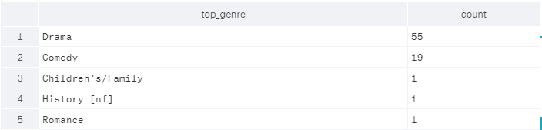
Answer
SELECT top_genre, COUNT(*)
FROM(
SELECT a.*, b.top_genre
FROM tutorial.oscar_nominees a, tutorial.nominee_information b
WHERE winner = 'true'
AND category = 'actress in a supporting role'
AND a.nominee = b.name
) c
GROUP by 1
ORDER by 2 DESC

Slide 62
CHALLENGE II
How many men have won best actor between the ages of 20 and 30? (Including 30)
Hint: to pull a year/month/day from a date use EXTRACT(YEAR/MONTH/DATE FROM date_column)
Beware: There are different category names for best actor depending on the year.

Slide 63
More Hints
There are multiple ways to get the answer. Try using:
tutorial.oscar_nominees, tutorial.nominee_information
SELECT from multiple tables
Nested selects
COUNT
BETWEEN
IN
Table Aliases
Arithmetic in SELECT statement

Slide 64
ANSWER
SELECT COUNT(*)
FROM (
SELECT a.nominee,
a.movie,
a.year,
a.year - EXTRACT(YEAR FROM b.birthday) as Age
FROM tutorial.nominee_information b, tutorial.oscar_nominees a
WHERE b.name = a.nominee
AND a.winner = 'true'
AND category IN ('actor in a leading role','actor')
ORDER by 3) z
WHERE z.Age BETWEEN 20 and 30

Slide 65
Nested SELECT
We can SELECT from our SELECT statements!
SELECT _____
FROM (
SELECT _____
FROM table
WHERE _____
) Alias
WHERE Alias.column = ?

Slide 66
Example I
SELECT *
FROM (
SELECT date,
(high - low) as intraday_range
FROM tutorial.aapl_historical_stock_price
) a
WHERE a.intraday_range > 20

Slide 67
Why use a Relational database
Think about a list of contacts in Excel – basically one database table – and adding a phone number.
Do you have enough phone number columns?
Does cell phone have its own field or is it just another phone number?
How do you mark the primary phone number?
A database lets you have as many phone numbers as you want associated with one person, because you can put phone numbers in a separate table.

Slide 68
Structured query language
SQL is a way to pull the information you need out of a relational database
You’ll probably use it to fetch summary information from a central data warehouse and then do additional analysis in Excel/SAS/etc.
SQL is also used (by the people who set up the data warehouse) to create tables, insert data, and delete unneeded information.

Slide 69
Credits
Jennifer Berk, Booth Tech Club
Patrick Miller, former BAC co-chair

Slide 70
LIMIT
Mode automatically limits results to 100. You can uncheck the box to get the full table.
You can also customize your own limit in your query
SELECT *
FROM tutorial.oscar_nominees
LIMIT 20

Slide 71
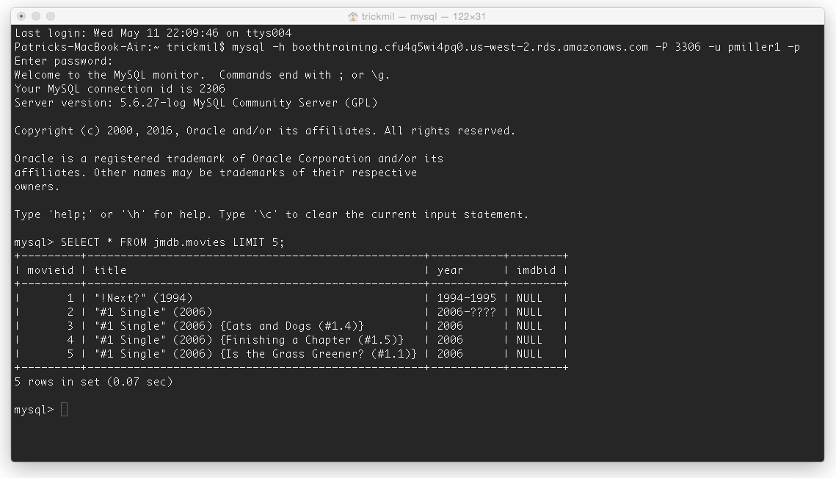
How do you use SQL?
For startups and smaller companies you might query SQL directly through terminal or command line

